Slide 1

Team Details
Hackstreet Boys
Jay Ajmera
Open Innovation in AI

Slide 2
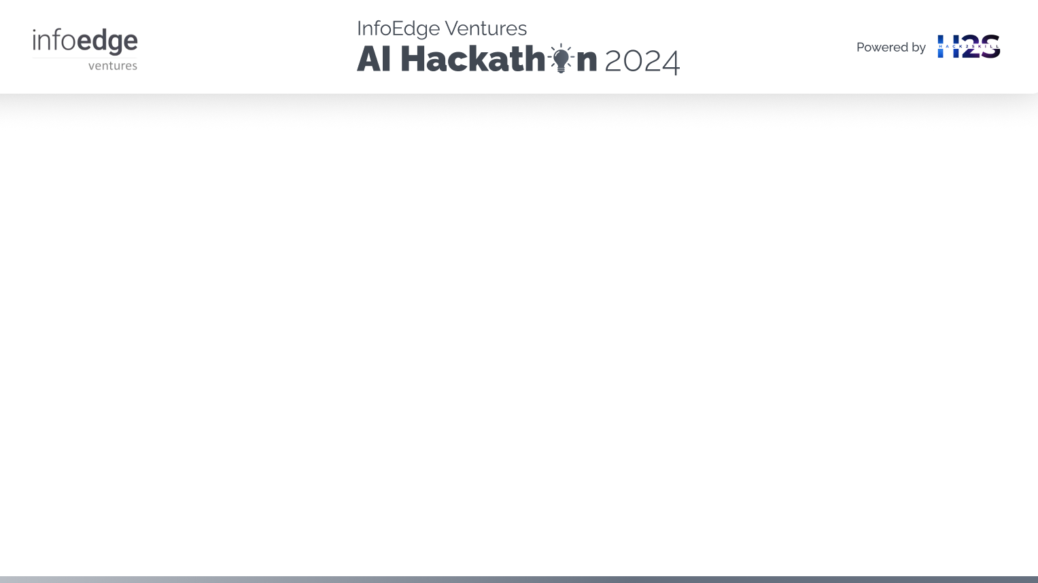
Brief About The Idea
This project presents the "Semantic Search-Based Medicine Recommender with LangChain and Google Search Agent," a system designed to suggest relevant medications for specific illnesses using advanced semantic search techniques.
The project leverages a large dataset of approximately 23,000 drugs and follows a comprehensive pipeline that includes data scraping, structuring, NLP sentence vectorization, and the generation of 1024-dimensional embeddings using the SBERT model. These embeddings are stored in a Neo4j graph database, enabling efficient retrieval through cosine similarity calculations.
The system features a chatbot interface that facilitates simple and intuitive user interactions, allowing for easy access to medication suggestions. The experimental results demonstrate a significant improvement in accuracy, precision, and recall compared to traditional keyword-based search methods. This project underscores the potential of integrating LangChain agents with semantic search algorithms to enhance the efficiency and robustness of medication recommender systems.

Slide 3
Opportunities
How different is it from any of the other existing ideas?
Semantic Search: Uses SBERT embeddings for contextual understanding, unlike keyword-based systems.
Dynamic Data Retrieval: Integrates LangChain Google Search Agent for real-time, up-to-date information.
Efficient Storage: Utilizes Neo4j graph database for handling large datasets.
Large Dataset: Covers approximately 23,000 drugs for comprehensive recommendations.

Slide 4
Opportunities
How will it be able to solve the problem?
Accurate Recommendations: Semantic search improves the relevance and accuracy of medication suggestions.
Real-Time Data: Provides the latest information through dynamic data retrieval.
Efficient Handling: Manages large datasets efficiently with Neo4j.
User-Friendly: Easy interaction through a chatbot interface.

Slide 5
Opportunities
USP of the proposed solution
Semantic Understanding: SBERT embeddings offer deep semantic insights.
Real-Time Updates: LangChain integration ensures fresh and relevant data.
Efficient Management: Neo4j database supports fast, efficient queries.
Comprehensive Coverage: Extensive dataset for a wide range of recommendations.
Accessible Interface: User-friendly chatbot for easy access to information.

Slide 6
List of features offered by the solution
Semantic Search: Uses SBERT embeddings to understand the context of user queries for accurate medication recommendations.
Real-Time Data Retrieval: Integrates LangChain Google Search Agent for up-to-date information.
Extensive Database: Covers approximately 23,000 drugs with detailed information.
Efficient Storage and Retrieval: Utilizes Neo4j graph database for fast and effective data handling.
User-Friendly Interface: Provides an intuitive chatbot for easy and accessible user interaction.

Slide 7
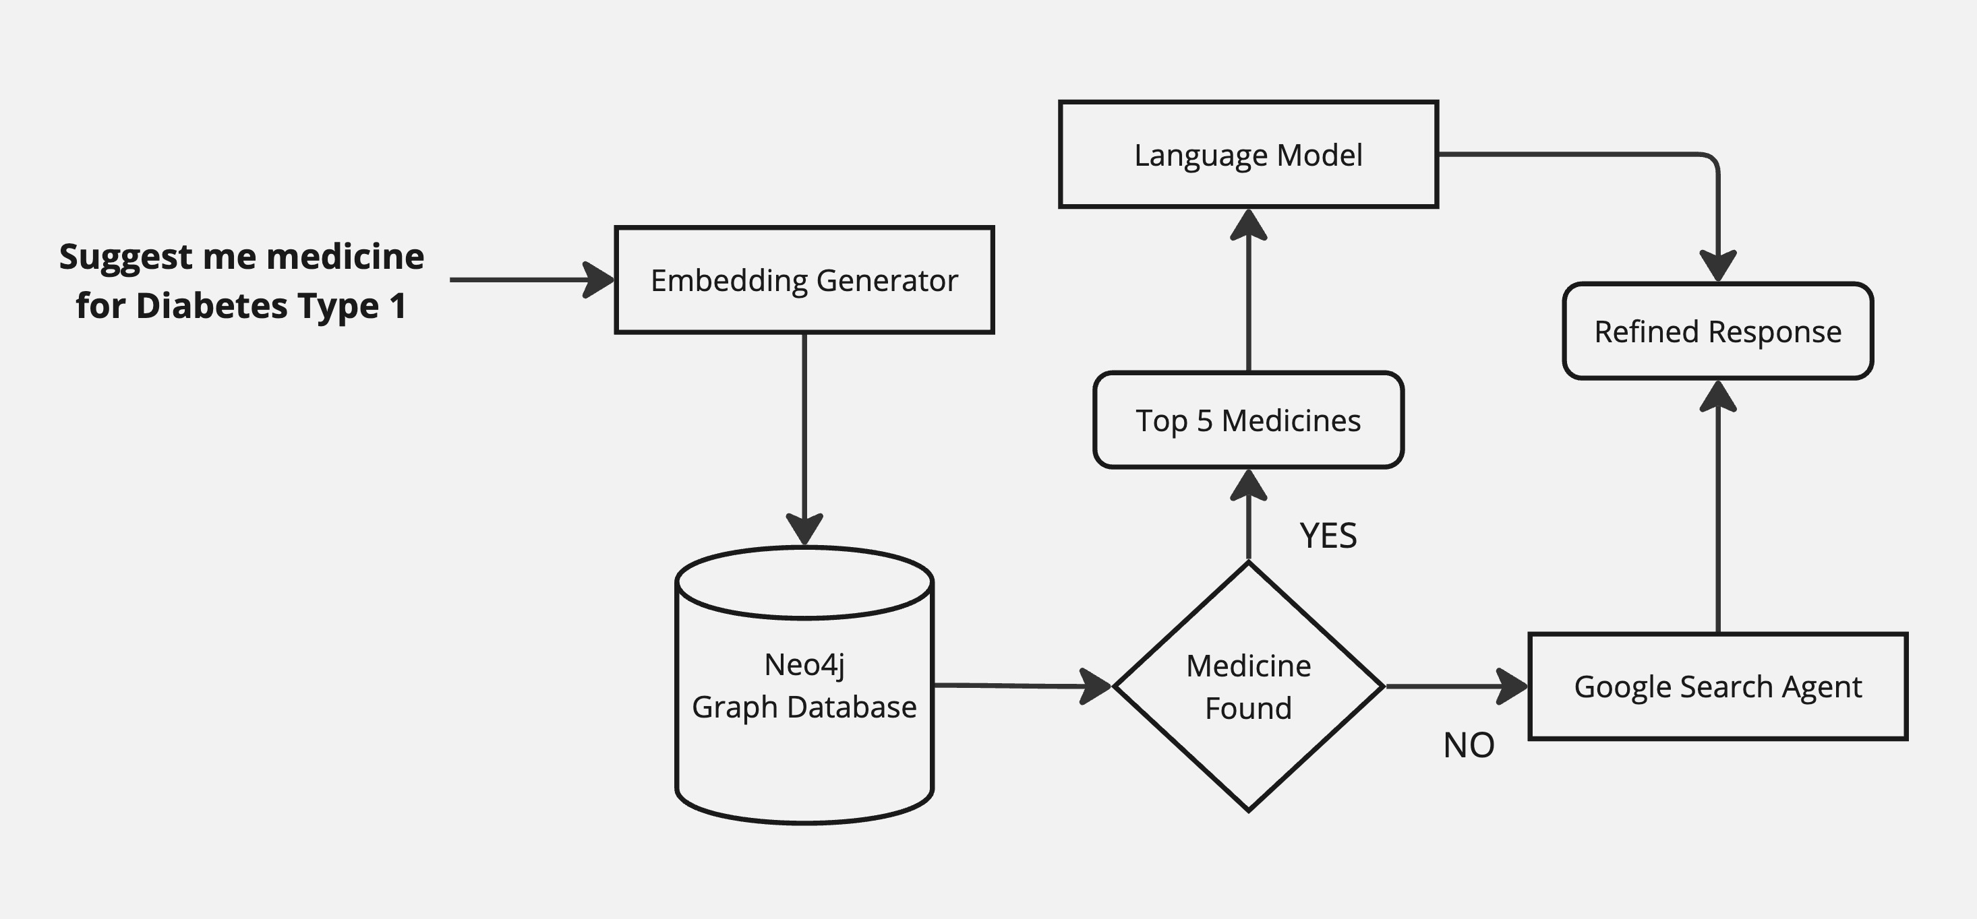
Process flow diagram or Use-case diagram

Slide 8
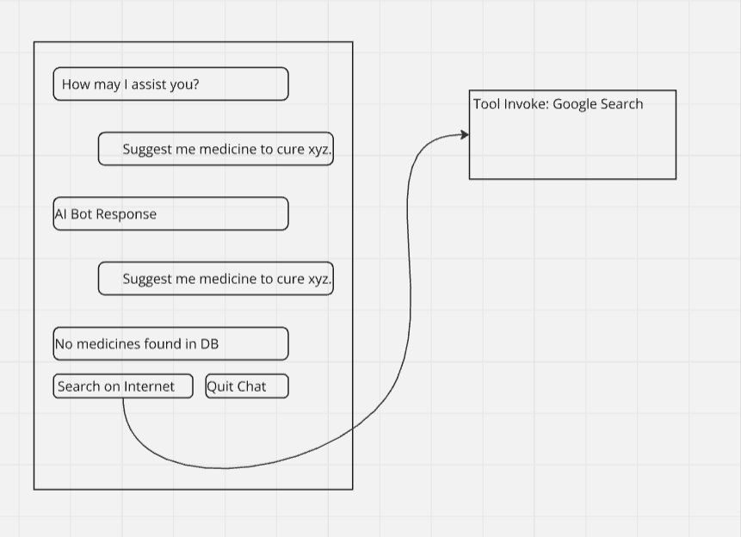
Wireframes/Mock diagrams of the proposed solution (optional)

Slide 9
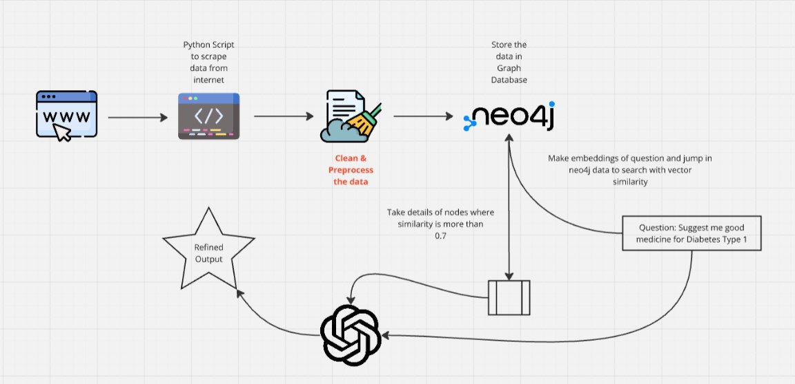
Architecture Diagram of the Proposed Solution

Slide 10
Technologies to be used in the solution
SBERT (Sentence-BERT):
For generating high-dimensional semantic embeddings to understand and process user queries and medical descriptions.
LangChain:
To enable real-time search functionalities through a Google Search Agent, ensuring the system retrieves the most current information.
Neo4j:
A graph database for efficient storage, management, and retrieval of the embeddings and drug information.
Flask:
A lightweight web framework for building the backend of the application, handling API requests, and managing interactions between the user interface and the system.
Gemini Pro:
For enhanced data processing and optimization capabilities, improving the overall performance of the system.

Slide 11
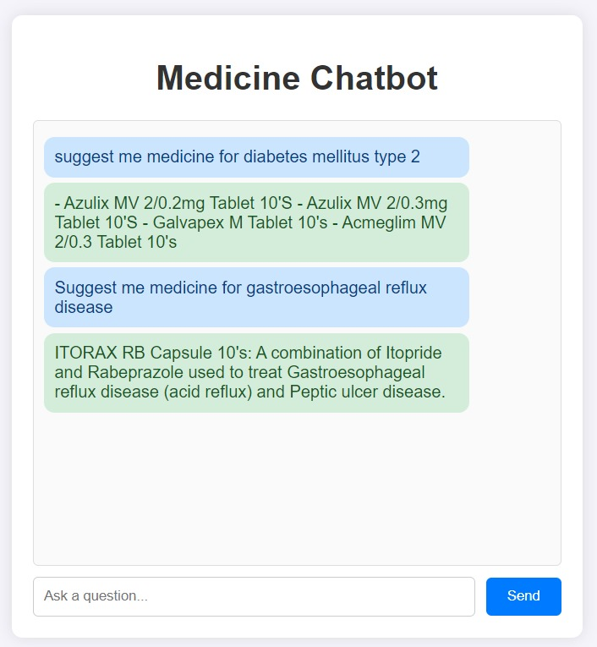
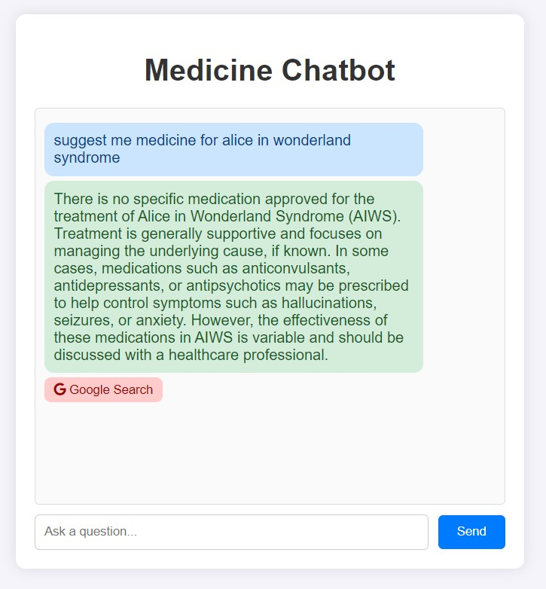
Snapshots of the prototype

Slide 12
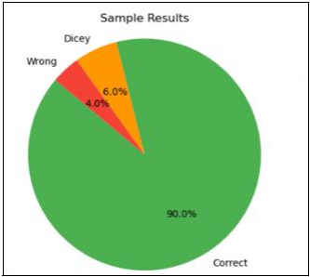
Prototype Performance report/Benchmarking
Total Sample used were 50 out of which 45 showed correct results, 3 gave partially correct outputs (medicine to be consumed only after medical consultation) and 2 failed to return correct response

Slide 13
GitHub & Demo video URL
GitHub Link
Demo Video Link

Slide 14


